Slide 1
A proposed solution by FX Software
Proactive Sales Support

Slide 3
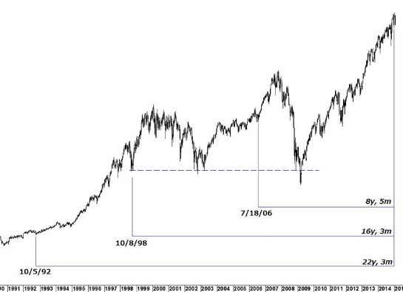
The idea
Know your customer
Market movements
Advice
Sales history

Slide 4
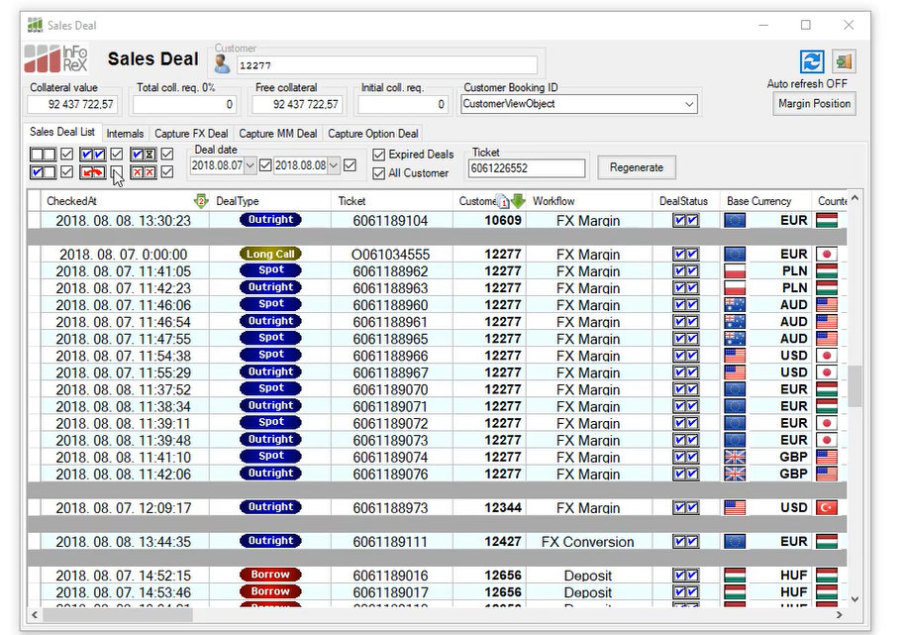
Treasury Sales Desk module

Slide 5
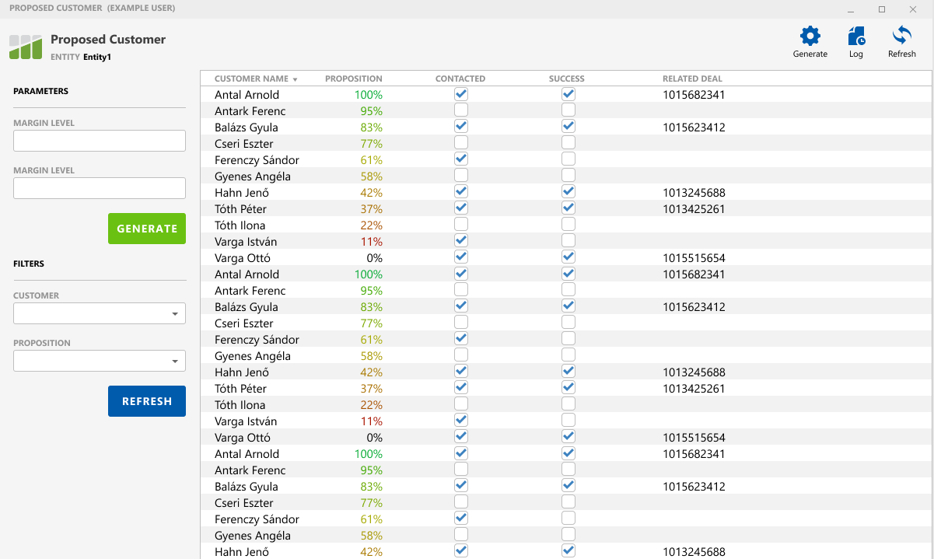
Preliminary screen design
Augmented Intelligence to help dealers to generate business.

Slide 6
Where does the information come from?
Bloomberg
Real time market data flow from B-PIPE e.g.
InFoRex treasury & CRM
Other systems
InFoRex own database which contains the banks historical sales activity
Other internal or external source

Slide 7
What kind of information?
Account balances (margin, free)
Open position
Limit usage
Number of margin calls
Margin level
Deal activity (size, rythm, time of day)
Market movements (exchange rates, curves)
Dynamic
Customer data
MIFID data
Contract data
Static

Slide 8
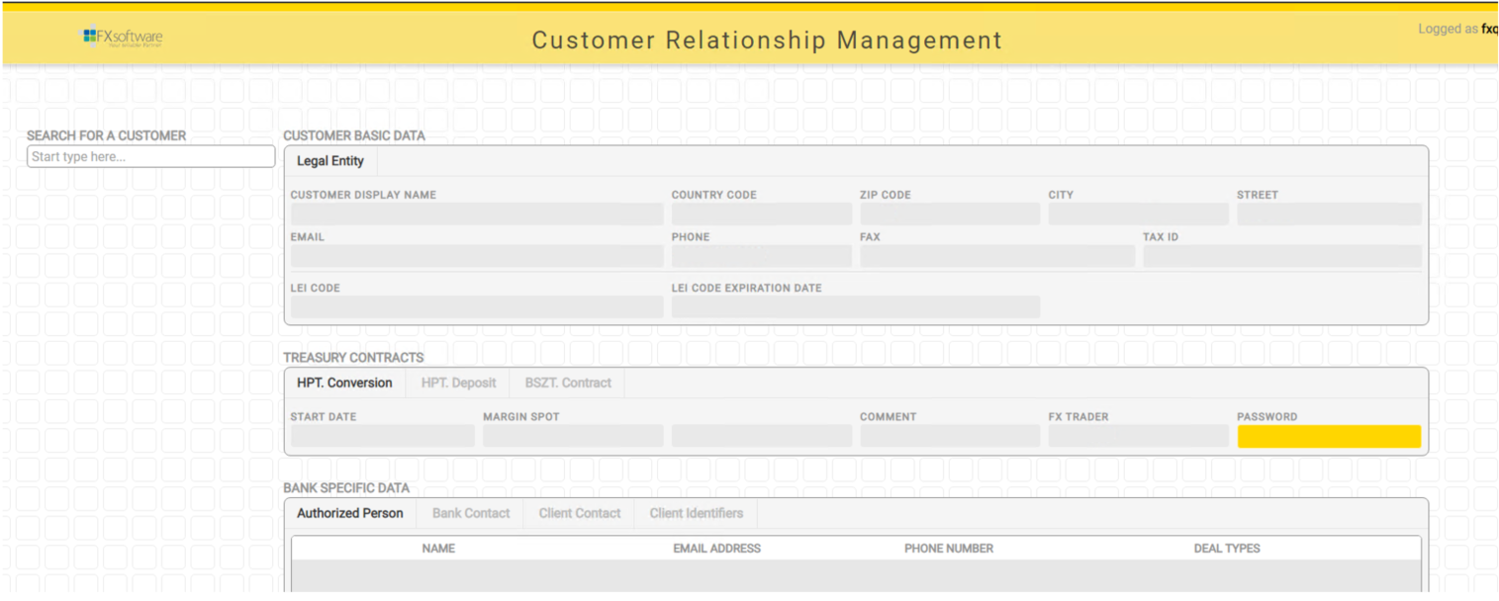
Could it be better?
With our CRM plugin, mood detection also can be available.
More available dynamic data:
Comment quantity
Comment quality
Contact activity
Declined deals

Slide 9
About the concept
Preparation
Input data selection
Transformation
Transform into one numeric matrix
Modelling
Learning process
Near-time evaluation, based on data flow
Evaluating
Keras & TensorFlow
Data harmonization
End of day process
About Keras model:
Layers are the basic bulding blocks of the model. A layer consist of inputs-transformation-output set with various parametrization possibilities (e.g. linear or non-linear regression layer, dropout layer, for those interested: https://keras.io/api/layers/ )
The optimization also has a wide range of parameterization possibilities (what and how we value the goodness of the model).
The scientific work which has to done before any coding in the system, is to find the proper parameter set(s) to the business problem.

Slide 10
Roadmap
Idea generation, usability research of AI in treasury.
Concept development, tool selection, business case specification.
Development and early bird access to the AI solution.
2021
2022
2023
„Scientific work”, functional and technical specification.
Rewrite and redesign of entire sales module of InFoRex.

Slide 11
Questions
?

Slide 12
Thank you for your attention!
Contact:

